Slide 1
Session 1
Developing Web Applications
– An Overview

Slide 2
Session Objectives
Describe the Web development process
Describe a typical server-side application
  Using TCP / IP and HTTP protocols
  Including GET, POST and Form Header methods
Describe contemporary server-side technologies
  CGI
  Server-side Java Scripts (SSJS)
  Servlet
  JSP
  ASP
  PHP
Compare contemporary server-side technologies with JSP
Describe the advantages of using JSP

Slide 3
Introduction
The JSP technology is based on the Java programming language.
It inherits many of the Java language’s features and benefits.
Java makes the JSP technology available on almost every kind of computer and operating system.

Slide 4

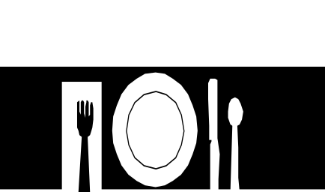



McDonald’s – a chain of restaurants
Food
Counter
He goes to the counter and places an order
A customer enters the restaurant
Order
--------
---------
Then he collects the items and leaves
He then pays the bill

Slide 5

McDonald’s – a chain of restaurants – (1)
Front end
Back end
places an order
Order is processed here
Client
Client-Server Architecture

Slide 6

McDonald’s – a chain of restaurants – (2)
Drawbacks of two-tier systems:
  Servers must be multi-lingual, as clients may speak different languages.
  Clients have to decide which queue is the shortest, to get their food quickly.
  People may have to wait in long queues at the counter.
  If the queues are too long, then a client may decide to leave.

Slide 7
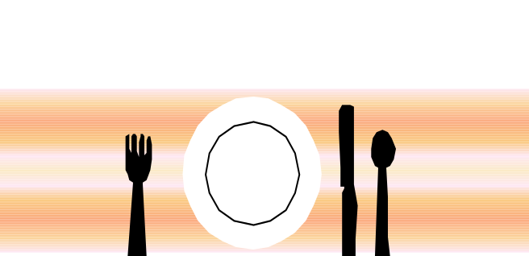

A day in a typical restaurant
A customer enters the restaurant
A waiter accepts the order and then serves food
Bill
Exit
The customer asks for the bill, pays the money and leaves the restaurant

Slide 8
A day in a typical restaurant – (1)
Advantages of this system:
  The customer does not have to stand in a queue. He has to just sit at a table and wait for his order to be taken.
  The client has to interact with a waiter only. Thus, the waiter alone needs to understand more than two languages.
  There is a separate counter for paying bills. So clients need not wait for the others to clear their bills first.

Slide 9
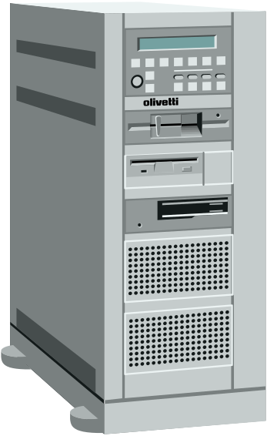
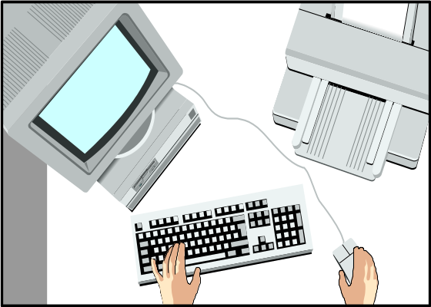
The Web based solution
He places an order (request) based on the available menu, which is received by the Web server
Process
The request is processed here, by the JSP engine
The results are sent back to the client
The database is checked for any required information – like stock of items
A customer browses the restaurant site on the Web, located at a particular URL
Database

Slide 10

The Web based solution – (1)
The process of placing an order and being served by the waiter can be explained as follows:
  Placing an order, which is accepted by the waiter, is comparable to an HTTP request
  Being served by the waiter is similar to receiving an HTTP response
  The entire mode of communication, that is sending and receiving HTTP requests and responses is based on the TCP/ IP suite

Slide 11
The Web development process – Some definitions
Web Page:
  simple text file consisting of text and HTML tags.
Web Browser:
  connects to a Web Server, sends a request for a page and receives and displays the result.
  interprets HTML tags to display the page exactly the way the designer wanted it to be.

Slide 12
The Web development process – Some definitions – (1)
Web Server:
  software that can respond to a Web browser’s request for a page, and then send that page to the browser
Database:
  an RDBMS that stores data – connected to the Web Server

Slide 13
A brief note on TCP/IP and HTTP protocols
TCP/IP is a protocol suite that drives the Internet.
Handles network communications between nodes.
It is composed of layers:
  Internet Protocol.
  Transmission Control Protocol.
  Sockets.

Slide 14
A brief note on TCP/IP and HTTP protocols – (1)
HTTP defines
  how messages are formatted and transmitted,
  what the Web servers and browsers shall do in response to various commands.

Slide 15
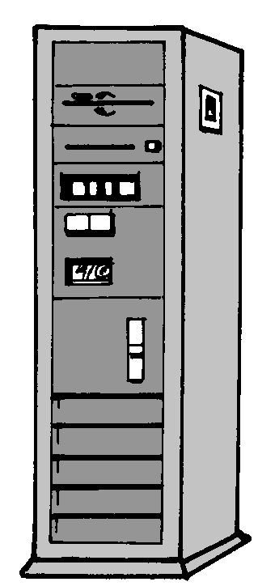
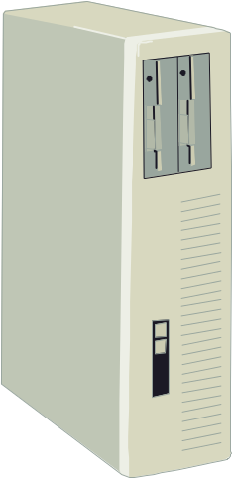
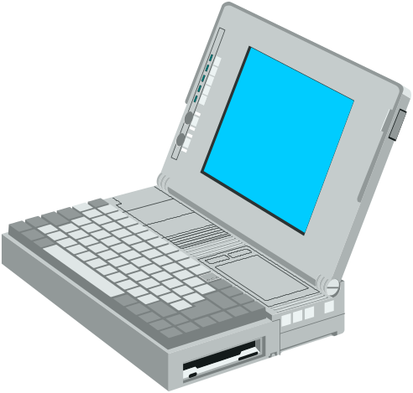
Connecting the client and server through HTTP
HyperText Link
HyperText Link
80
80
80
T C P
T C P
T C P

Slide 16

How does a Web server work?
When a browser sends a request to the Web server, the following occur:
  The browser divides the URL into three parts –
    The protocol (HTTP)
    The server name (www.Microsoft.com)
    The file name (index.asp)
  The browser communicates with this server to translate the server name into an IP address

Slide 17
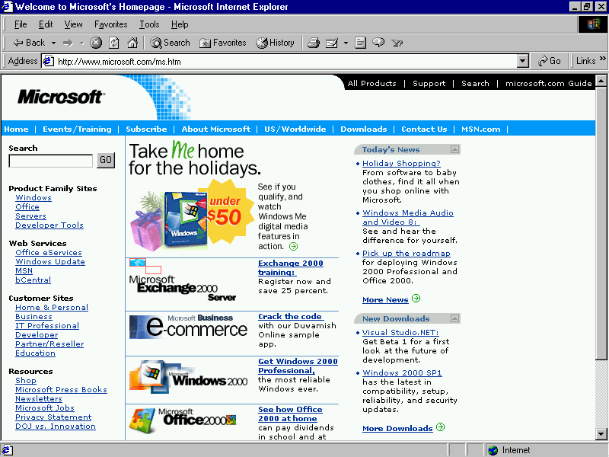
How does a Web server work?
5
Server returns the HTML page
4
Browser sends a GET request
2
www.Mi…
Translate
IP address
80
1
3
Connection
3. File name – index.asp
2. Server name – Microsoft.com
1. Protocol – HTTP

Slide 18
How does a Web server work? – (1)
http://servername/HelloWorld.html
Request
File system contains HelloWorld.html
Response

Slide 19
Web Application architecture
Browser
First Tier
Middleware
Second Tier
Database
Third Tier

Slide 20
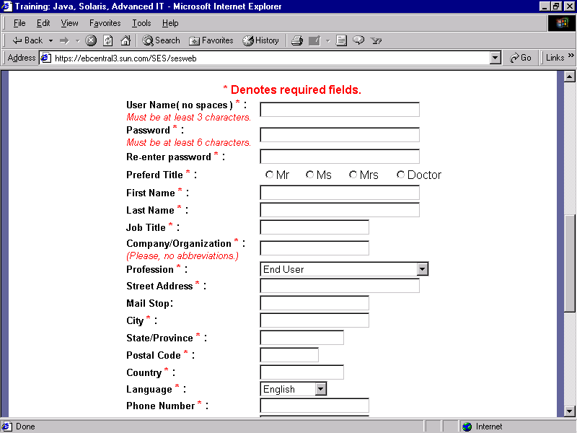
Web Application architecture – (1)
Returning Results to the browser
4
Executing the Server Script
3
Sending a Request to the Web
2
Collecting Data
1

Slide 21
The Prevalent Server-side Technologies
Common Gateway Interface (CGI)
  Perl is the most popular programming language for CGI programming
  CGI acts as a gateway between a request and the response
  Disadvantage is that it does not scale well – a new process is created each time the server receives a new request

Slide 22
The Prevalent Server-side Technologies – (1)
Proprietary Web Server APIs (ISAPI, NSAPI)
  Allow developers to write server applications as shared libraries
  These libraries can service multiple requests without creating a new process for each of these

Slide 23
The Prevalent Server-side Technologies – (2)
Server-side Java Scripts (SSJS)
  Uses JavaScript as the scripting language
  Has built-in features for
    database and e-mail support
    session management
    inter-operability with server-side Java classes

Slide 24
The Prevalent Server-side Technologies – (3)
Personal Home Page (PHP)
  Provides strong support for pattern matching and database access
  Is an open source product and is available on a large number of platforms
Servlet
  Small Java-based applications for adding dynamic functionalities to Web servers
  Servlet requests are handled by threads

Slide 25
The Prevalent Server-side Technologies – (4)
Active Server Pages (ASP)
  Supports multiple scripting languages, including PerlScript, JScript, and VBScript
  Has one limitation – it can run only on IIS on Windows NT
JavaServer Pages (JSP)
  Supports two different styles for adding dynamic content – through scripts and tags
  Separates presentation from implementation logic

Slide 26
Various server-side technologies vs. JSP
No built-in support for sessions
Low scalability
New process is created for each request
C G I
Maintains state on the server between requests
High scalability
Spawns a new thread for each request
J S P

Slide 27
Various server-side technologies vs. JSP – (1)
Works on Microsoft’s IIS and PWS
Code is interpreted for every instance
Basic languages used – Jscript, VBScript
Components include COM/ DCOM
A S P
Works on all major platforms
Code is interpreted only once
Basic language used is Java
Components include JSP Tags, JavaBeans and EJBs
J S P

Slide 28
Various server-side technologies vs. JSP – (2)
An object written in Java, equipped to
receive a request and generate a response
No distinct division between presentation
and application logic
Servlet
JSP specification is built on top of the Java Servlet
APIs.
Clear distinction between presentation logic and
application logic
J S P

Slide 29
How Do JavaServer Pages Work?
HTTP
WEB
SERVER
JSP
ENGINE
Client
Database
JSPs are processed here
JSP Files

Slide 30
Steps involved in processing a request
Request is sent to JSP Engine
1
Sends a
request
3
4
Web
Server
2
Web
Client
JSP
File
Servlet
6
Output is sent back
HTML
File
5
Response is sent to the client

Slide 31
A Simple Web Application
HelloWorld.html
<HTML>
<TITLE> A Simple HTML file with HTML extension </TITLE>
<BODY>
<H1> Hello JSP Programmer! </H1>
</BODY>
</HTML>

Slide 32
A Simple Web Application – (1)
HelloWorld.jsp
<HTML>
<TITLE> A Simple HTML file with JSP extension </TITLE>
<BODY>
<H1> Hello JSP Programmer! </H1>
</BODY>
</HTML>

Slide 33
A Simple Web Application – (2)
HelloWorld2.jsp
<HTML>
<TITLE> A Simple JSP file </TITLE>
<BODY>
<H1>
<% out.println("Hello JSP Programmer!");%>
</H1>
</BODY>
</HTML>

Slide 34
A Typical Web Application
A flexible application with Java Servlets
Request
Servlet
Web Client
Invokes
Response
JSP

Slide 35
A Typical Web Application – (1)
JSP combined with Enterprise JavaBeans technology
HTTP/HTML/XML
Browser
JSP
EJBs
RMI/IIOP

Slide 36
The benefits of using JSP
Separation of the content generation from the presentation
  HTML/XML tags
  Scriptlets, JavaBeans
Emphasizing reusable components
  JavaBeans, EJBs
Simplifying page development with tags
  Easy-to-use, JSP technology specific tags
Integrated with J2EE and Enterprise JavaBeans

